Slide 1

Amazon Sales Analysis
By: Uzman Ansari
Email : uzman786ansari@gmail.com

Slide 2


Amazon Company and Sales Analysis A comprehensive overview of Amazon's business and sales performance
Introduction to Amazon
Sales Performance Overview
Revenue Growth: Annual revenue trends
Highlight key milestones and growth phases
Overview: Brief history and founding of Amazon
Founded by Jeff Bezos in 1994
Initial focus on online book sales
Expansion into a wide variety of product categories
E-commerce: Amazon.com platform
Amazon Web Services (AWS): Cloud computing services
Other Ventures: Amazon Fresh, Whole Foods, Amazon Go, and more

Slide 3

Problem Statement
Objective
Sales management has gained importance to meet increasing competition and the need for improved methods of distribution to reduce cost and to increase profits. Sales management today is the most important function in a commercial and business enterprise.
Overview: This presentation provides a detailed analysis of Amazon's sales data from 2010 to 2017. The analysis focuses on identifying key metrics and trends using advanced machine learning models.
The need for improved distribution methods, cost reduction, and profit maximization has never been greater.
Tools & Libraries
Solutions to Enhance Sales Management
Data Analysis: Python
Data Visualization: PowerBI
Libraries: Numpy, Pandas, Matplotlib, Seaborn
ML: sklearn, LinearRegression, RandomForestRegressor, KMeans
Data-Driven Sales Strategies:
Use predictive analytics to forecast sales trends and identify potential opportunities and risks.
e-learning platforms and interactive training modules to keep sales teams updated with the latest industry trends and best practices.

Slide 4

Analysis
Key Metrics
Total Revenue
Total Units Sold
Total Profit
Total Cost
Revenue by Region
Revenue by Item Type
Revenue by Sales Channel
Units Sold by Item Type
Processing Time
Profit Margin
Top selling items
Top selling regions
Top sales channels
Average order value
Attributes
Region: region where the order was placed
Country : where the order was placed
Item Type : Cosmetics, Baby Food, Office Supplies
Sales Channel : Online , Offline through sale was made
Order Priority : (C - Critical, H - High, L - Low, M - Medium)
Order Date: Which Date order was placed
Order ID : Unique identifier for each order
Ship Date: date when the order was shipped
Units Sold: Number of units sold in the order
Unit Price: Price per unit
Unit Cost: Cost per unit
Total Revenue:Total revenue generated from the order
Total Cost: Total cost from the order
Total Profit: Profit generated from the order.
Order Month: Month in which the order was placed, for seasonality analysis.
Order Year: Year in which the order was placed, for trend analysis.

Slide 5
Machine Learning Models Used
Linear Regression:
Purpose: Identify trends and relationships between variables
Insights: Trend lines, correlations
Random Forest:
Purpose: Determine the most important features affecting sales
Insights: Feature importance ranking
K-Means Clustering:
Purpose: Segment the data to find patterns
Insights: Identification of distinct sales clusters

Slide 6
Data Analysis

Slide 7
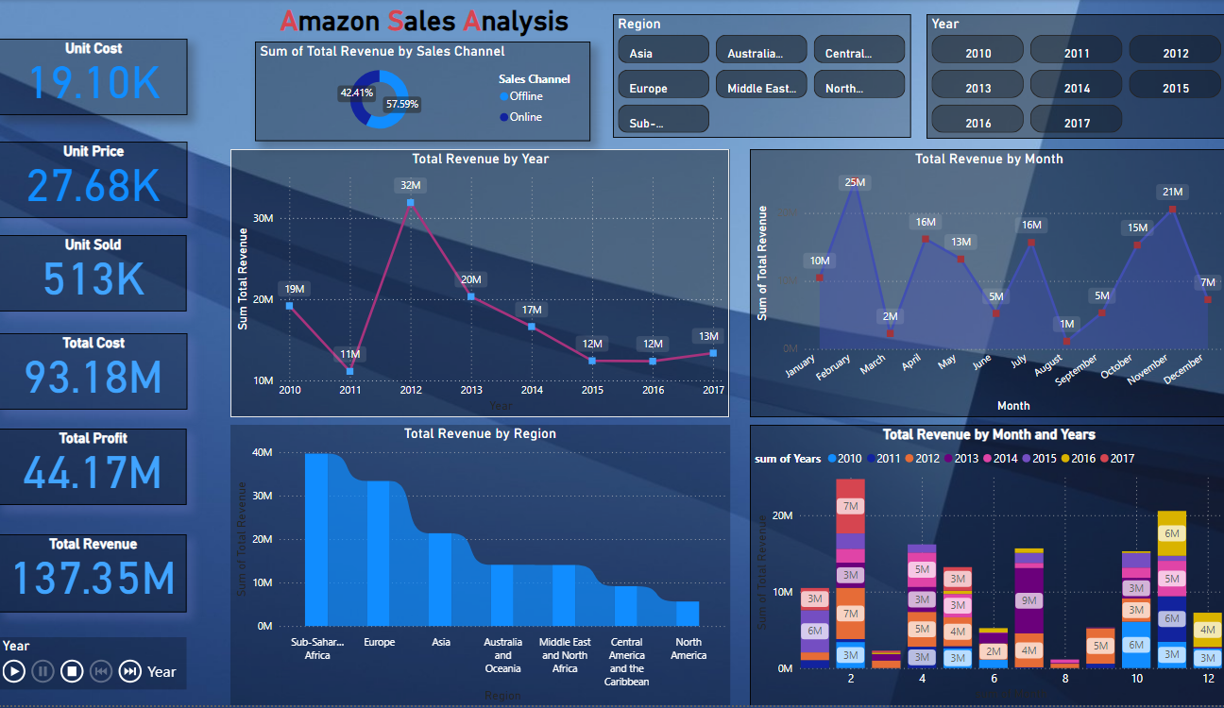

Slide 8
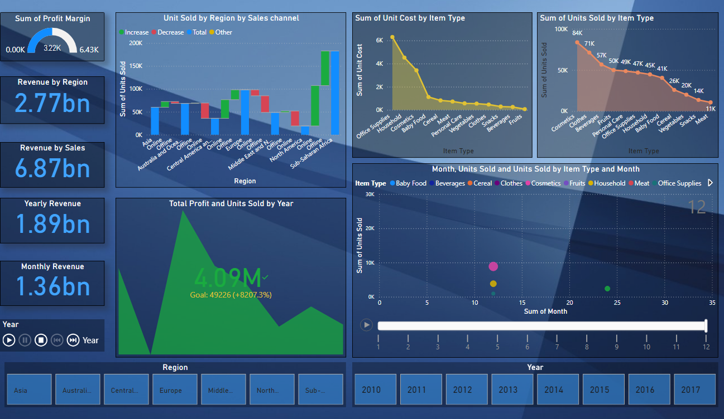

Slide 9
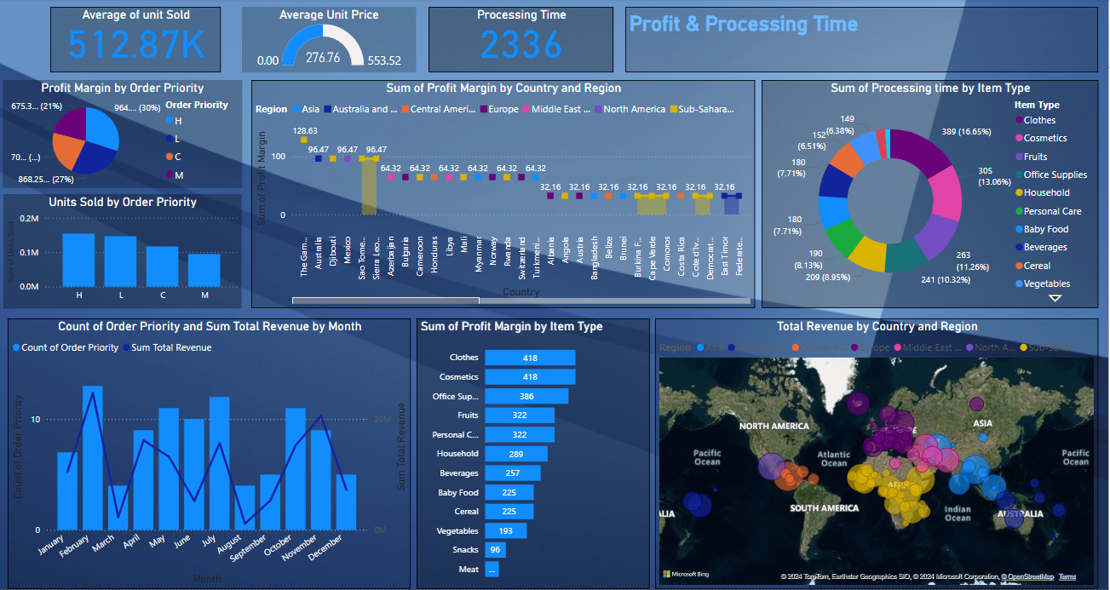

Slide 10
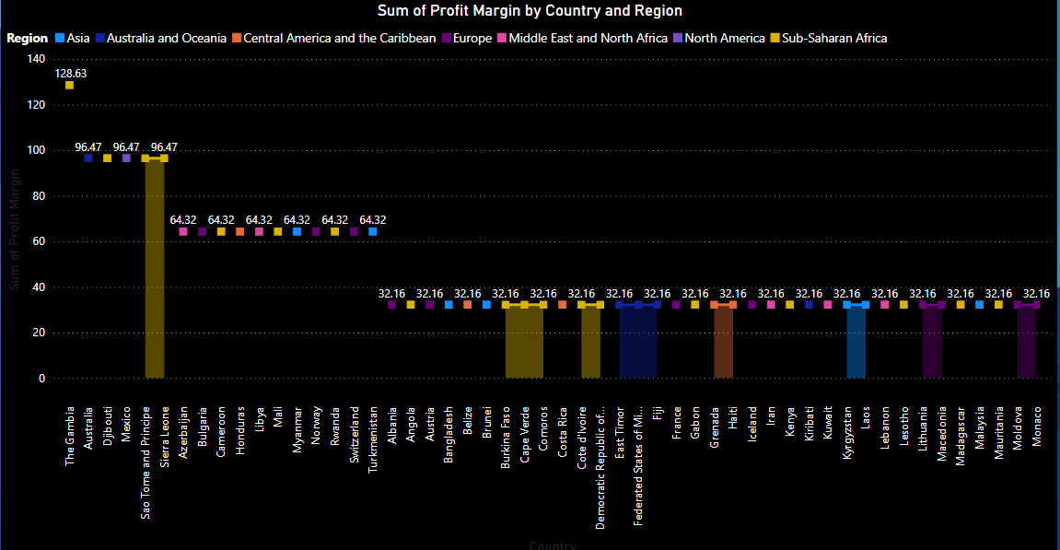
Profit Margin by Country and Region
By Country and Region:
Profit Margin by Country:
Cosmetics lead in revenue (36.60M) but have a moderate profit margin (39.77%)
Clothes combine high profit margin (67.20%) with substantial revenue (7.79M), making them highly profitable
Fruits ($0.47M) and have lower revenues but maintain modest profit margins (25.8%

Slide 11
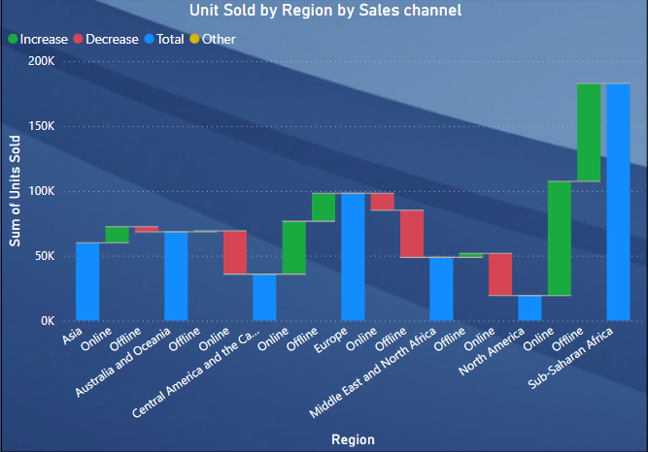
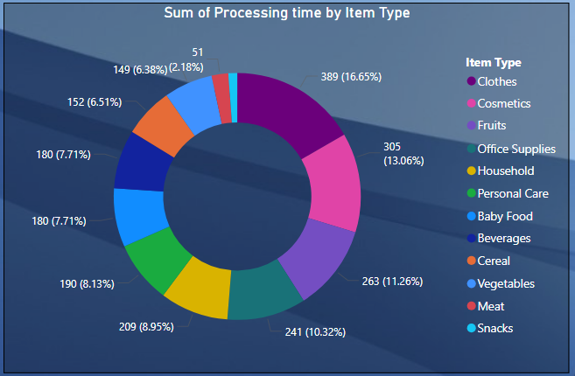
Unit Sold by Region by Sales channel
Sum Of Processing time by Item Type
Breakdown of units sold by region and sales channel (online and offline)
Identify Data Source: Ensure you have a dataset that includes columns for Item Type and Processing Time.
Filter Data: Extract rows corresponding to the specified item types:
Cosmetics 13.06 %
Clothes 16.65%
Household
Care
Baby Food
Meat
Snacks
Aggregate Data: Sum the processing times for each of the specified item types.

Slide 12
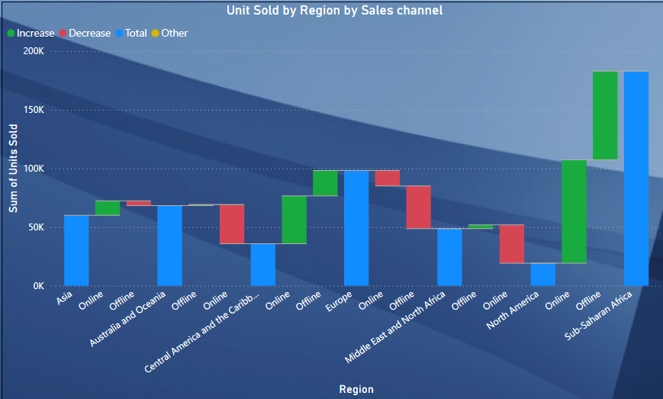
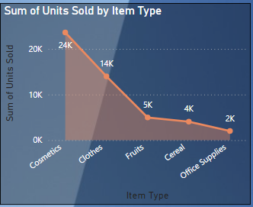
Unit Sold by Region by Sales channel
Sub-Saharan Africa 443.61M Revenue are the Top Customer
Sub-Saharan Africa and Europe : Leads in offline and online sales.
Europe 320.36M Revenue
Central America And The Caribb.. 100.1M Revenue
North America 60.98M Revenue
Middle East Top Cosmetic Customer
Office Supplies is lowest

Slide 13
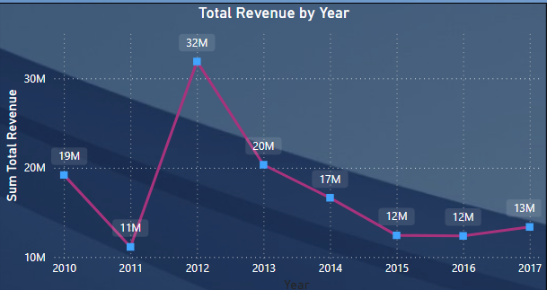
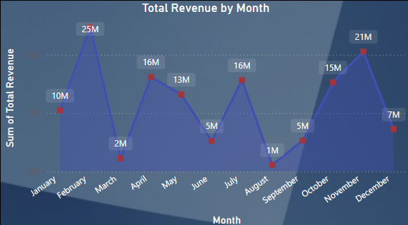
Sales Overview
Total Revenue by Years
Total Revenue: 137.35M
Total Units Sold : 513K
Total Profit : 44.17M
Total Cost : 93.18M
- Revenue highest in 2012 at 32M
- Revenue lowest in 2011 at 11M
fluctuations observed in subsequent years.
Total Revenue by Month
February and November
indicating seasonality in sales.
- Revenue lowest in August 1M
- Revenue in February 25M and November 21M

Slide 14
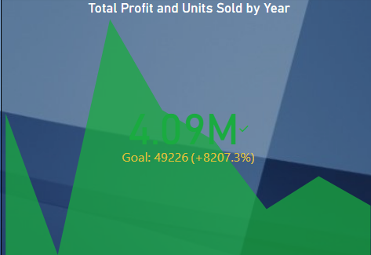
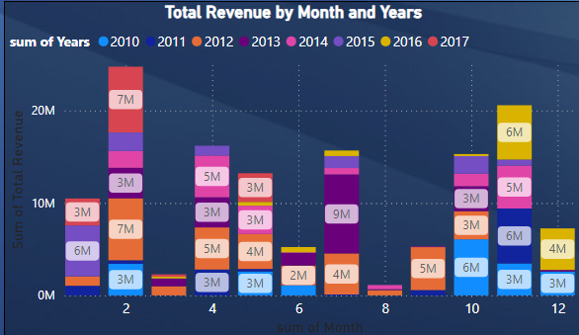
Total Profit and Units Sold by Year
By taking ,Total profit, Unit Sold And Year
4.09M Goal: 49226(+8207.3%)
Revenue in the 2nd month 2012 and 2017 ,7M
Revenue in the 11th month 2014 and 2016 , 5M, 6M
Revenue in the 7th month 2013 , 9M

Slide 15
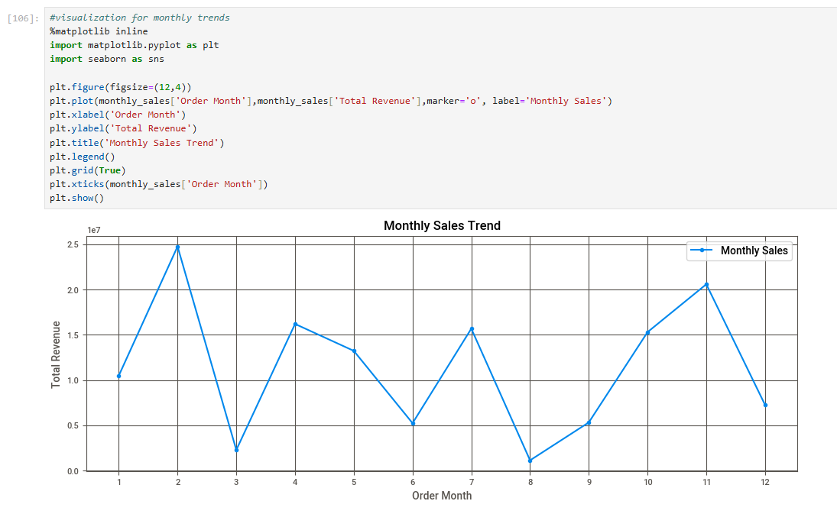
Monthly Sales Trend

Slide 16
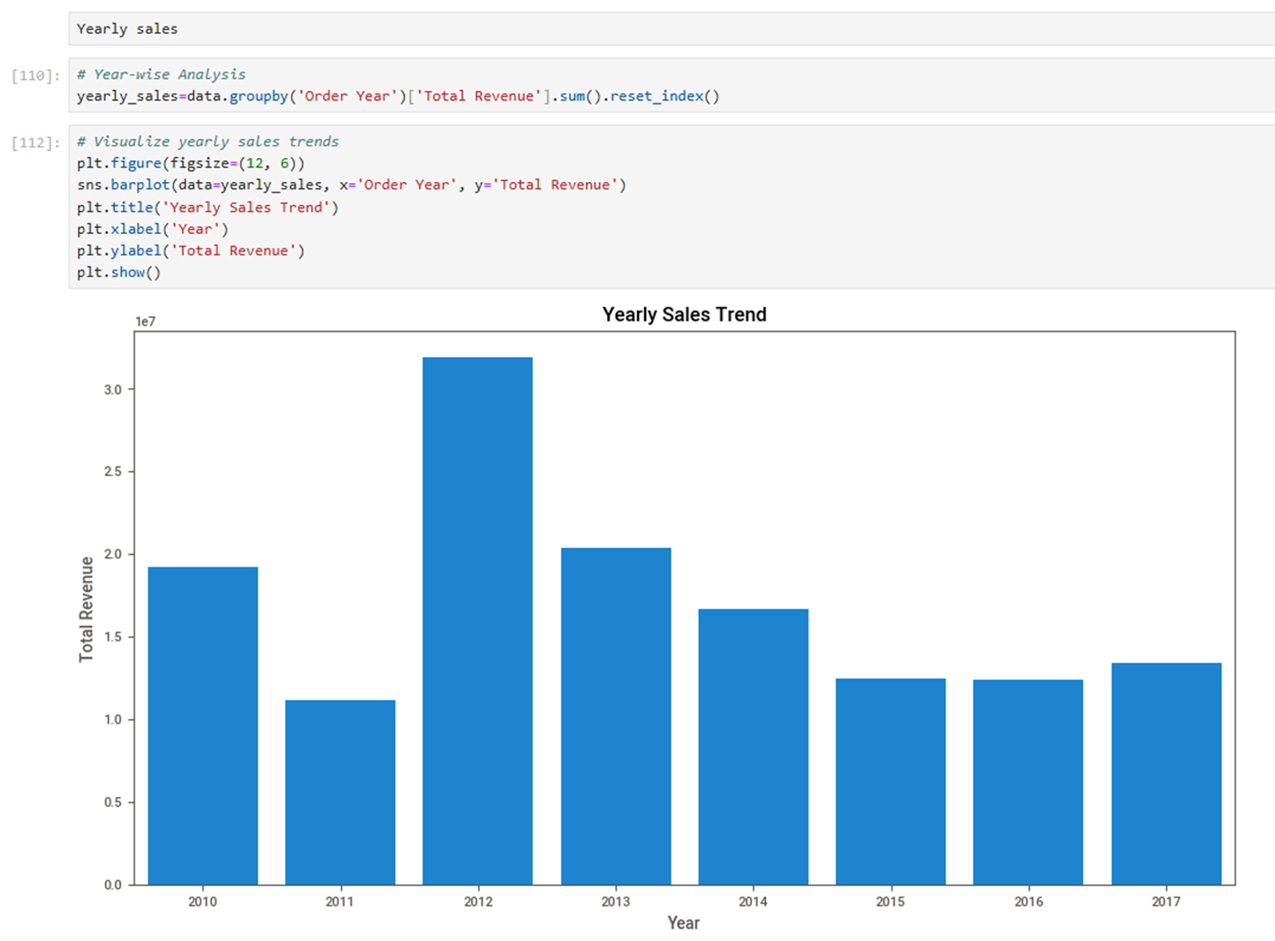
Yearly Sales Trend

Slide 17
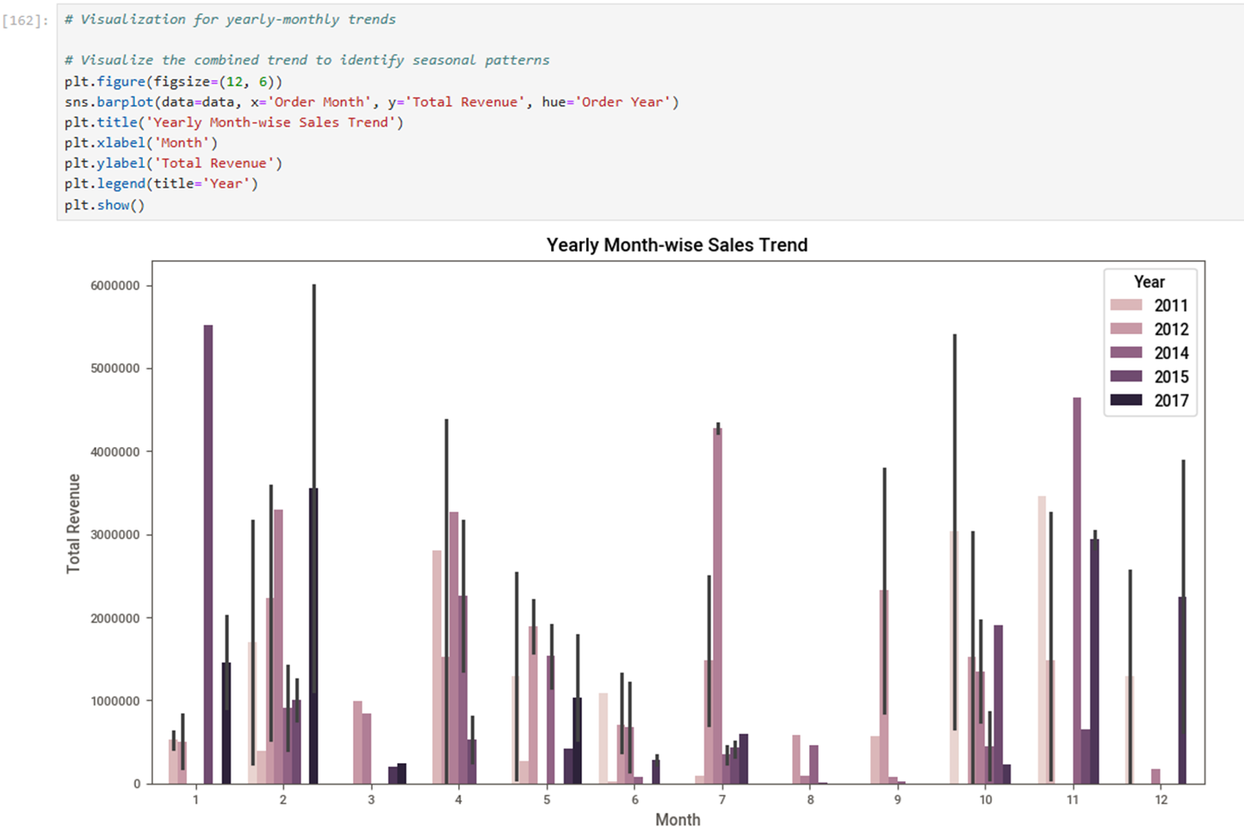
Yearly Month wise Sales Trend Month-wise Sales Trend

Slide 18
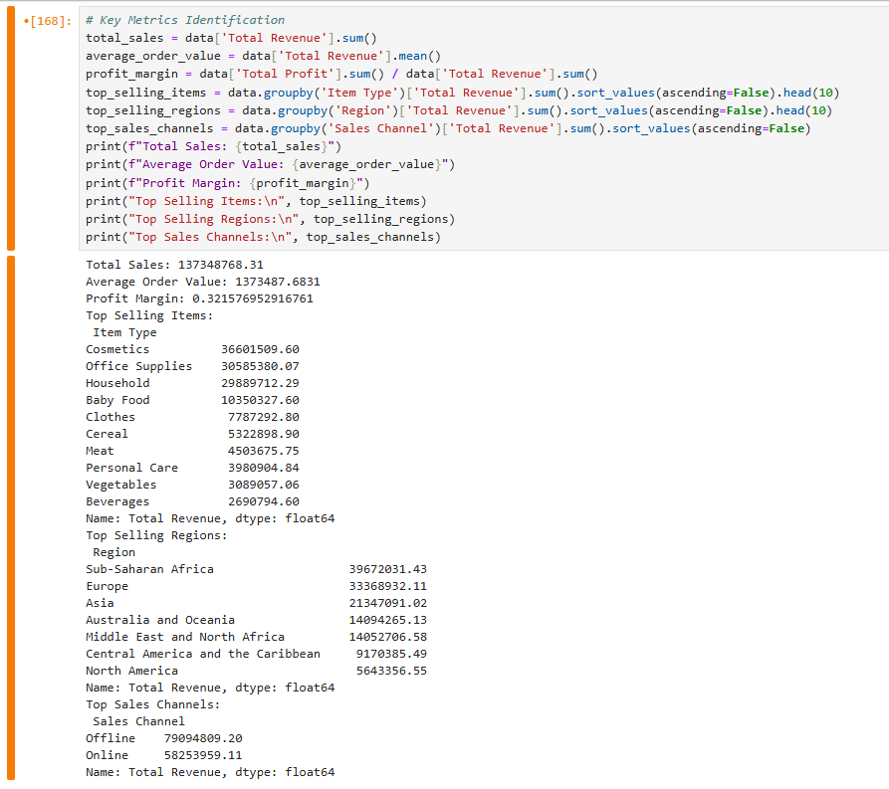
Key Metrics Identification

Slide 19
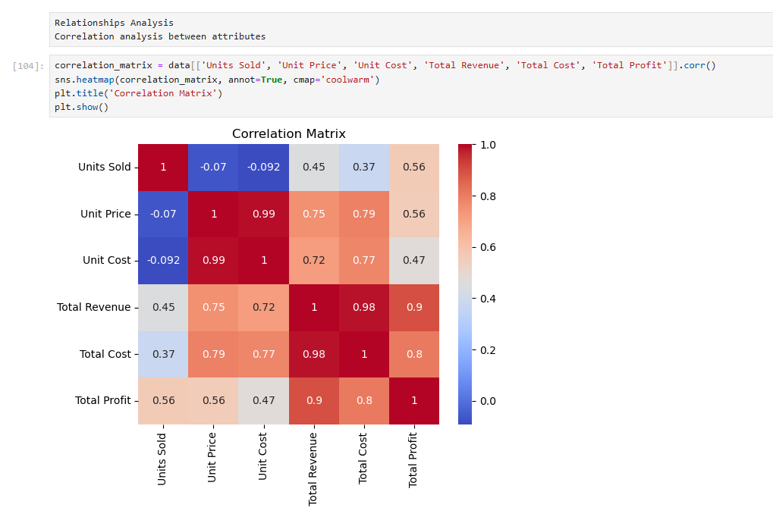

Slide 20

Thank You!

